Slide 1
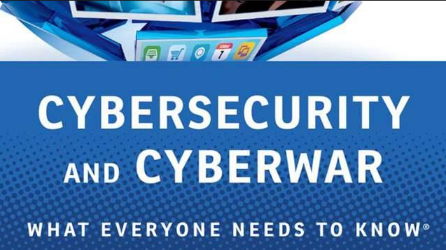
Paul A. Strassmann
New Canaan Mens Club – January 9, 2015

Slide 2
From individuals to organized groups.
Drug cartels, mafias, terrorist cells and nation-states.
RAND Corporation. http://www.rand.org/pubs/research_reports/RR610.html

Slide 3
Defenders protect 100.0%, all times.
Espionage succeeds in 0.01% of time.

Slide 4
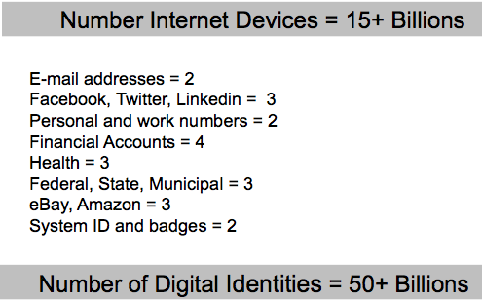

Slide 5
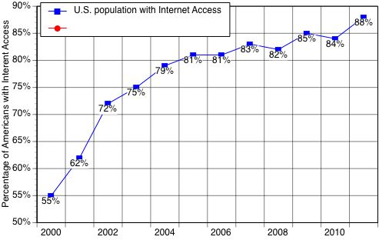

Slide 6
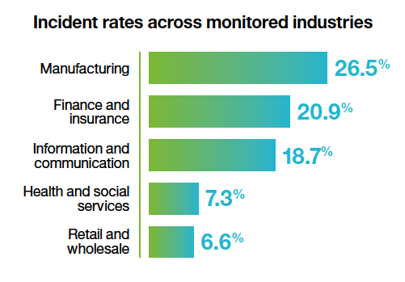

Slide 7
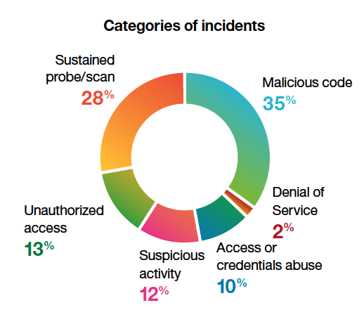

Slide 8
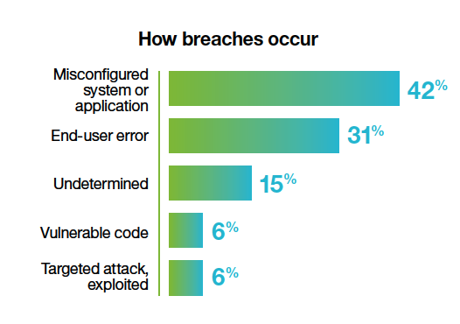

Slide 9
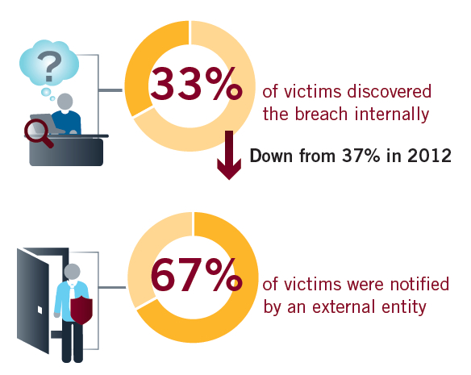
http://www.fireeye.com/blog/corporate/2014/04/annual-m-trends-report-looks-beyond-the-breach.html

Slide 10
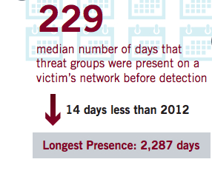
http://www.fireeye.com/blog/corporate/2014/04/annual-m-trends-report-looks-beyond-the-breach.html

Slide 11
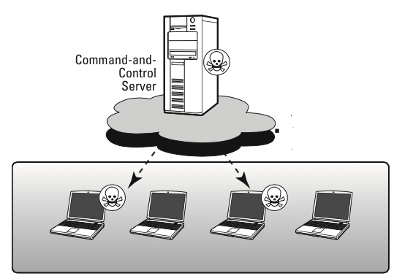

Slide 12
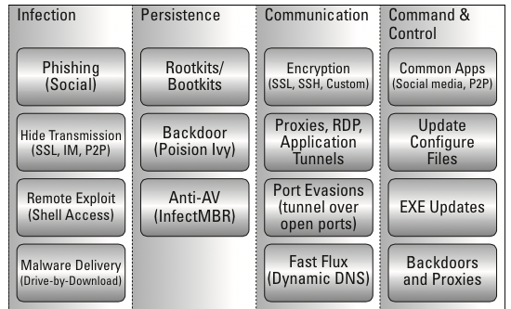

Slide 13
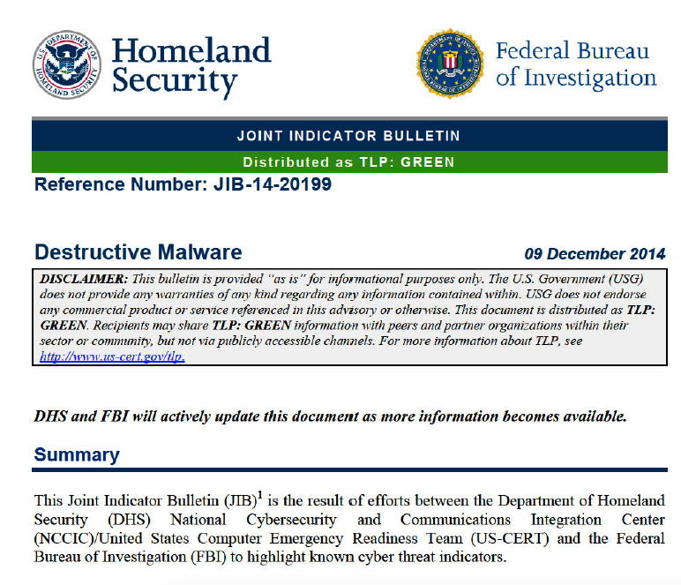

Slide 14
Typical large firm receives 50,000 intrusion/day
Pentagon reports 10 million attempts/day
Nuclear Security Admin: 10 million hacks/day
SOURCE (March 8, 2013):
http://www.nextgov.com/cybersecurity/2013/03/how-many-cyberattacks-hit-united-states-last-year/61775/

Slide 15
New Malicious Web Domains/day 74,000
Web Attacks Blocked/day 247,350
Bot Infections/day 3.4 millions
Avg. number of stolen identities 604,826
* http://www.symantec.com/- 69 million sensors, 2013

Slide 16
U.S. Critical Infrastructure
Chemicals
Communications
Critical Manufacturing
Dams
Defense Industrial Base
Emergency Services
Energy
Financial Services
Food and Agriculture
Government Services
Pharmaceuticals
Public Safety
Public Health
Information Technology
Nuclear Reactors
Transportation

Slide 17
Source of Losses
Cyber espionage
Cybertheft
Cybercrime
Loss of sensitive business information
Service and employment disruption
Insurance, and recovery costs
Competitive damage
Reputational damage
Loss of intellectual property
Loss of intangible assets

Slide 18
Sources of Cyber Attacks
Hactivists
Theft by Criminals
Organized Crime
Insider Compromises
Economic Espionage
Information Warfare
Government
Government proxies

Slide 19
U.S. Costs of Cyber Crime
Estimated Cost: $100 billion to $500 billion
Loss of 500,000 jobs
Loss to national security
SOURCE: https://csis.org/event/estimating-cost-cyber-crime-and-cyber-espionage

Slide 20
Pixel Tracker Bug Advertised (November 15, 2014)
Available for private database of 140,000.
Delivers e-mails, passwords, usernames and private messages of all the members.
Price: $90 via BitCoin.
Countermeasures: Disable Browser Feature

Slide 21
Information Warfare

Slide 22
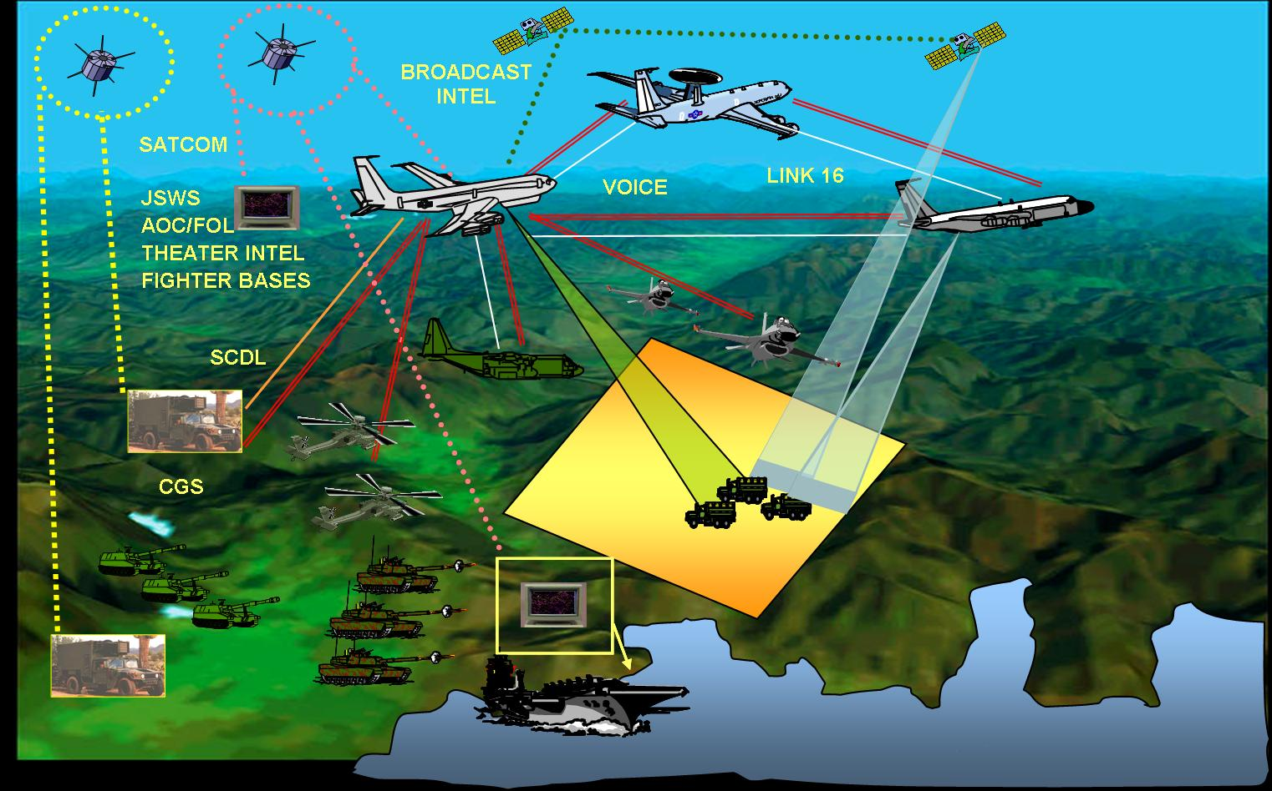

Slide 23
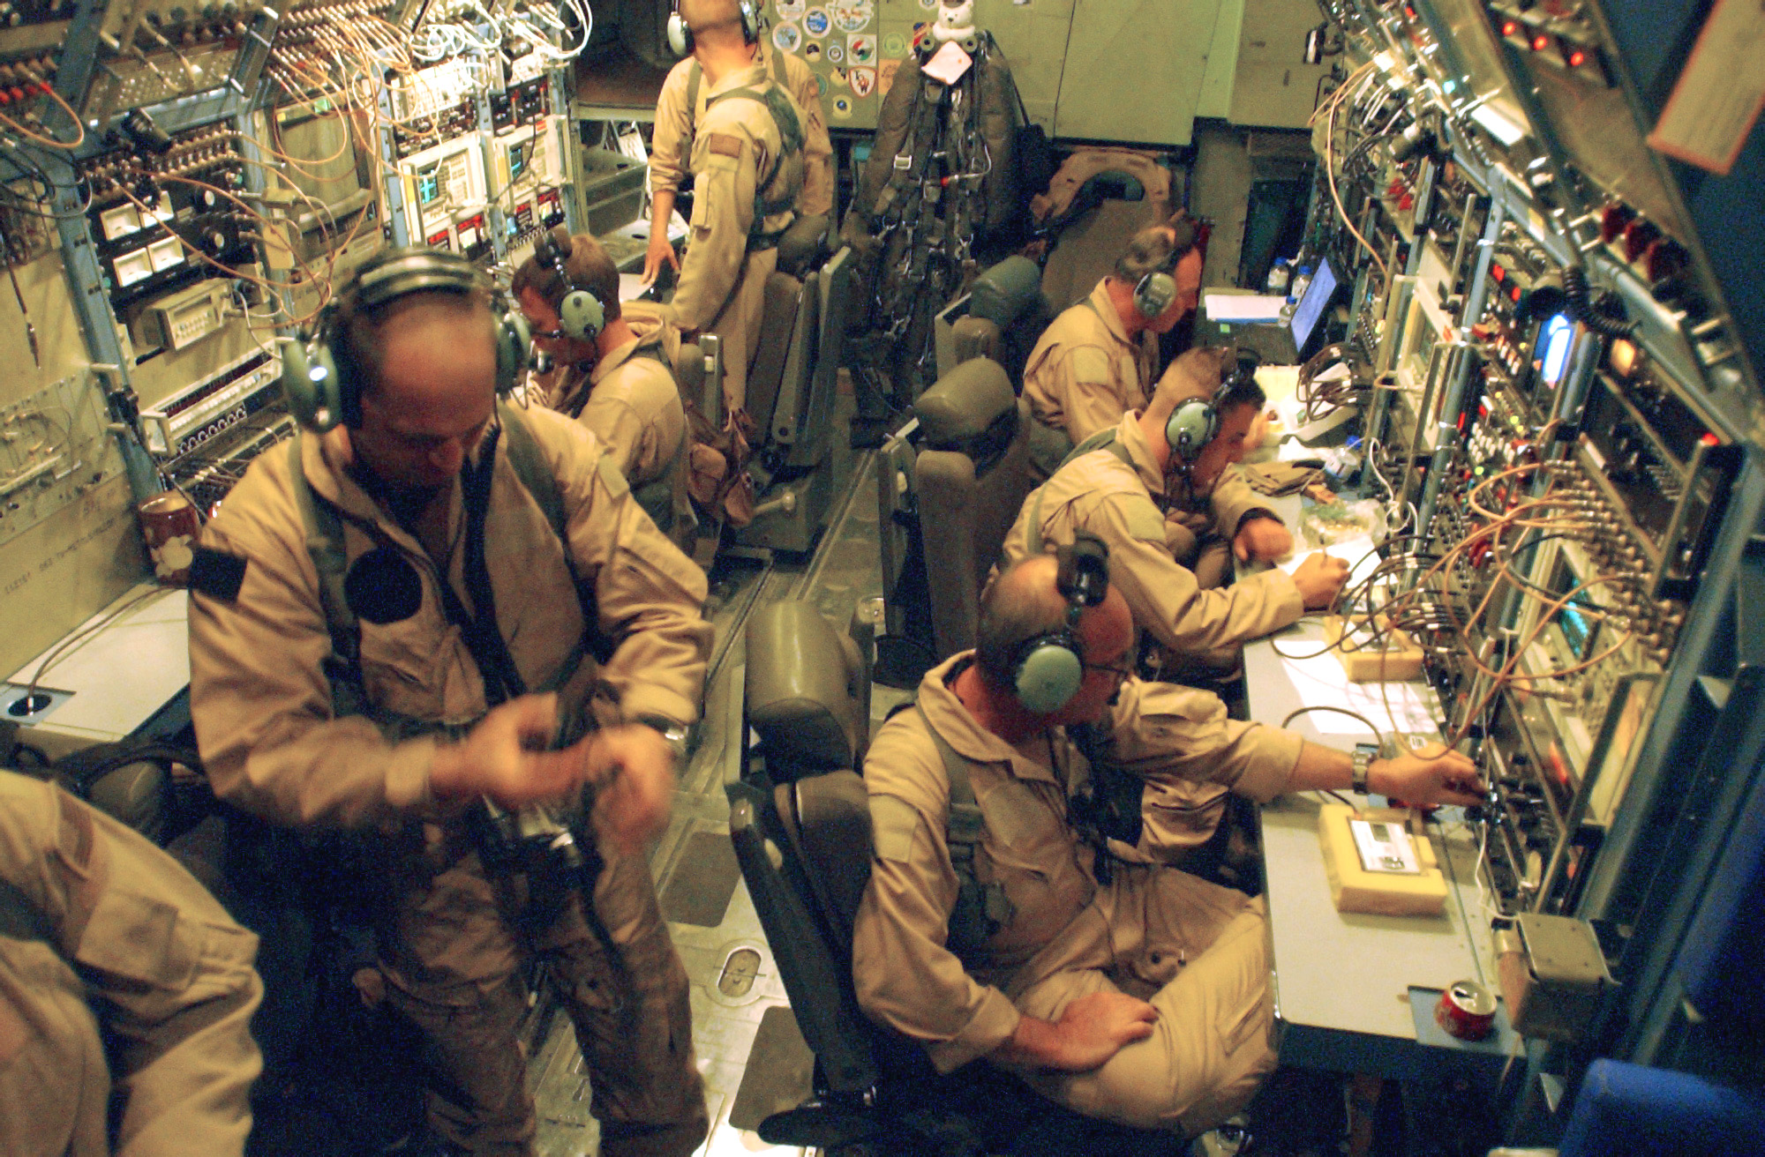

Slide 24
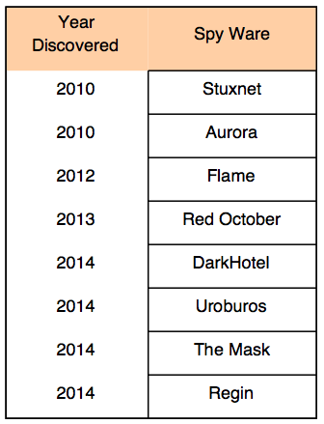
Major Information Warfare Programs

Slide 25
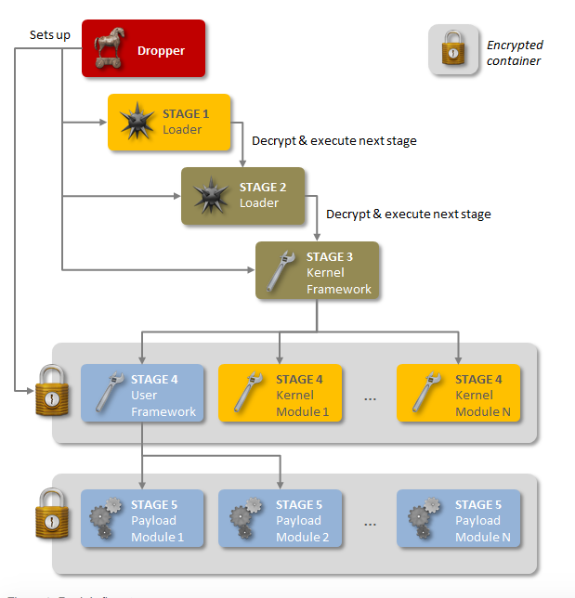

Slide 26
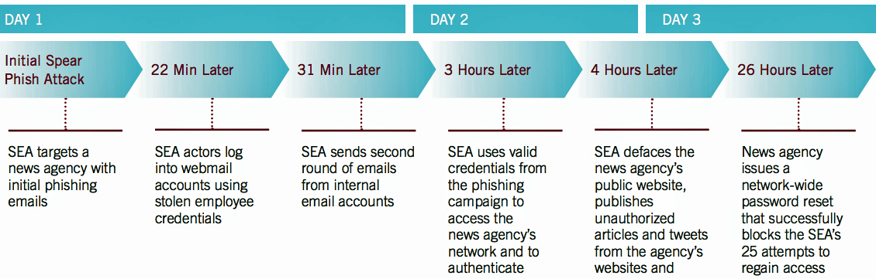
Example of a Simple Attack

Slide 27
Commercial Attack Tools Available for $10 to $50,000
Zeus: Cybercrime Suppliers in Russia
SpyEye: From Malaysia
Bugat v2: Origin unknown
Gozi Prinimalka Blitzkrieg: Russian
Carberp: Priced up to $40,000 for kit

Slide 28
Cyber Defenses

Slide 29
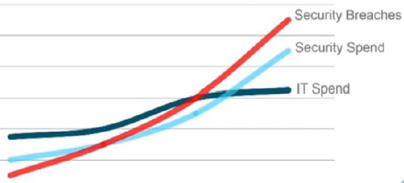
Costs of Security Exceed the Costs of Risks

Slide 30
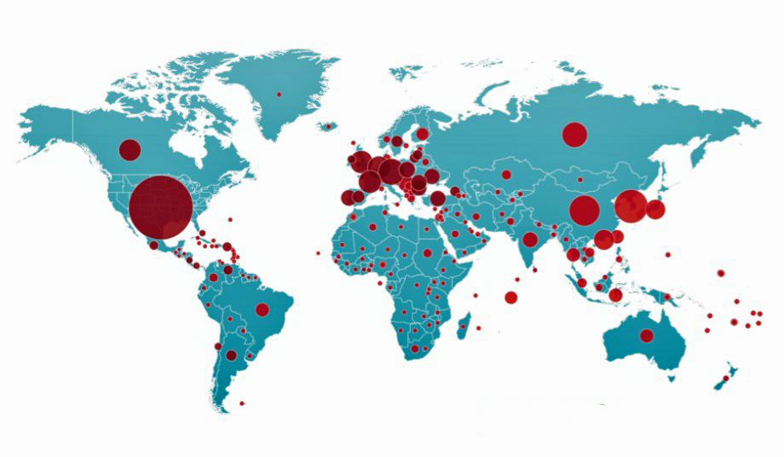
Distribution of Malware

Slide 31
Malware
Certified Definitions* 23,847,280
Additions During August 2013 136,051
* http://www.symantec.com/security_response/definitions/certified/ - 8/17/2013
** IDC #242346

Slide 32
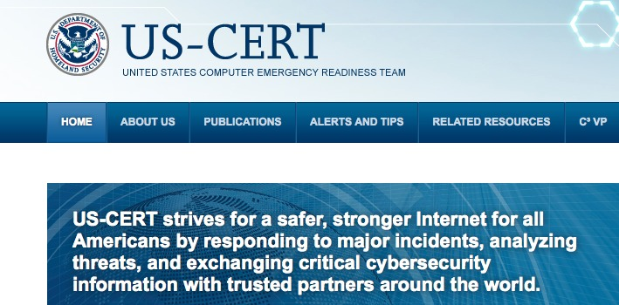
U.S. Computer Emergency Readiness Team

Slide 33

National Vulnerability Database
62,829 Vulnerabilities, June 2014

Slide 34
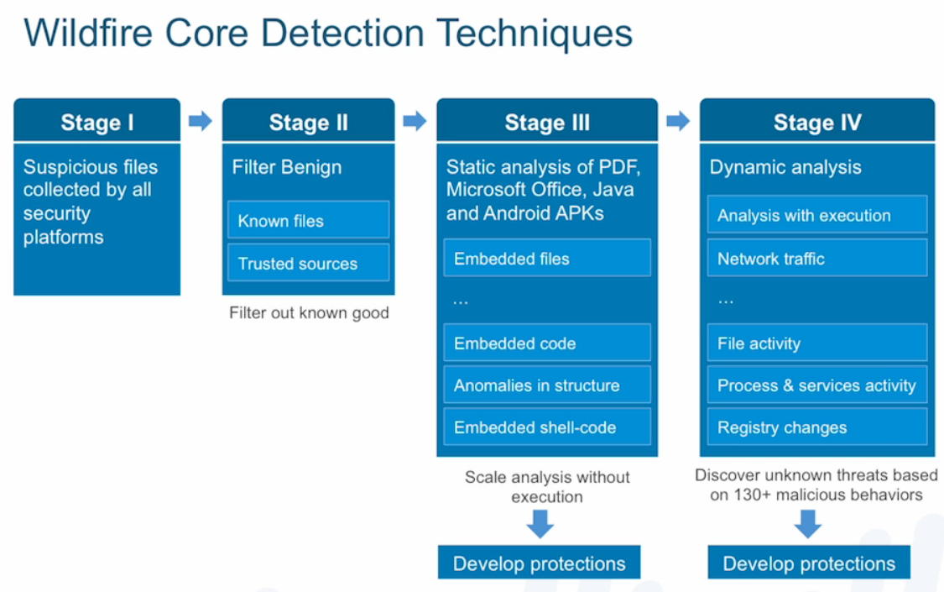

Slide 35
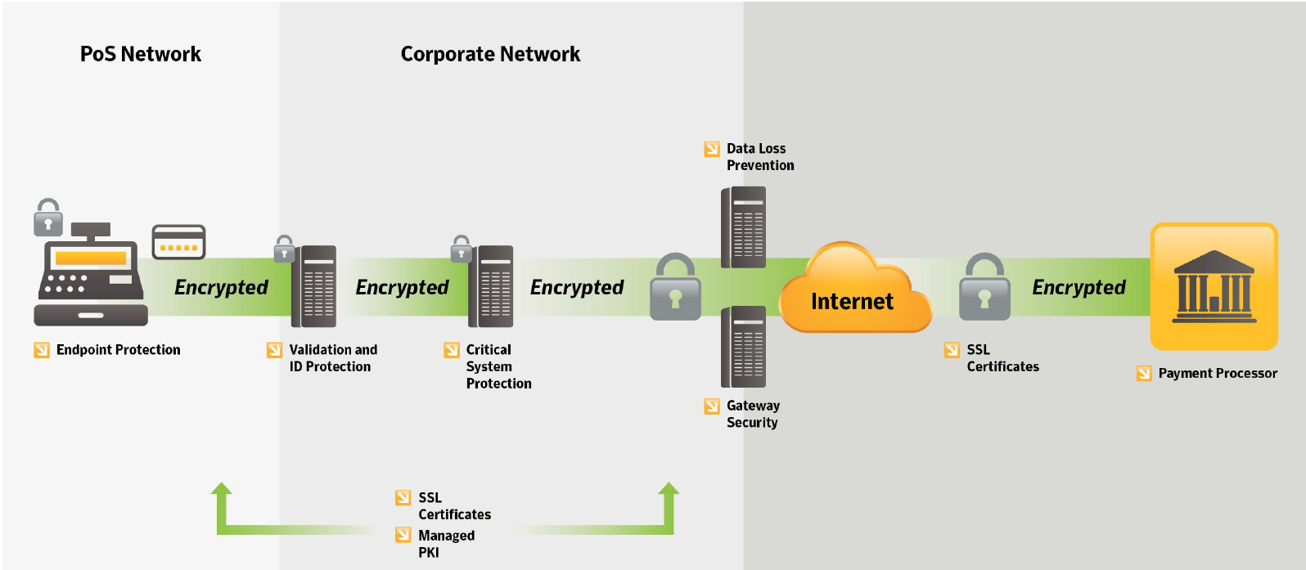
How to Defend a Point-of-Sale System

Slide 36
Personal Protection

Slide 37
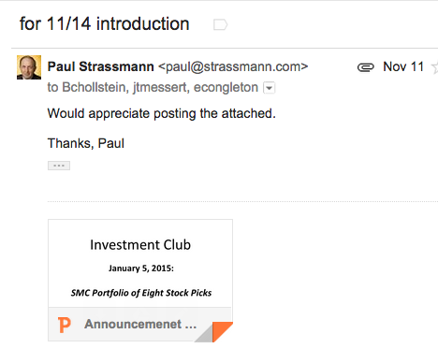
E-mail: Strassmann to Hollstein and Messert

Slide 38
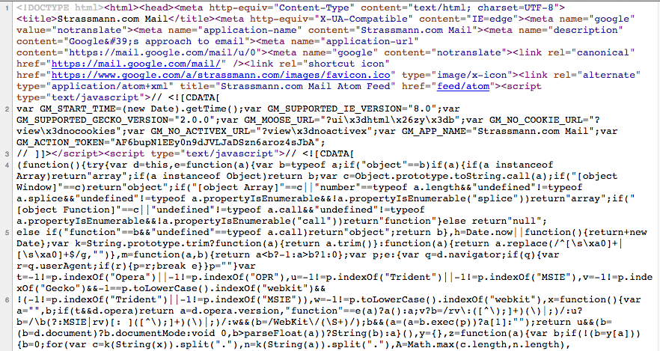
Sent to Hollstein and Messert

Slide 39
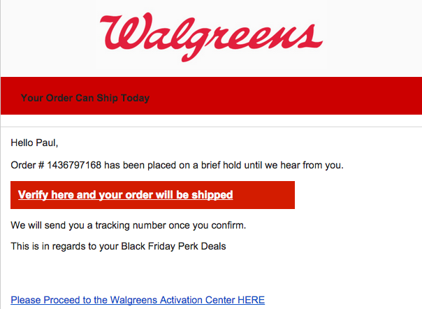

Slide 40
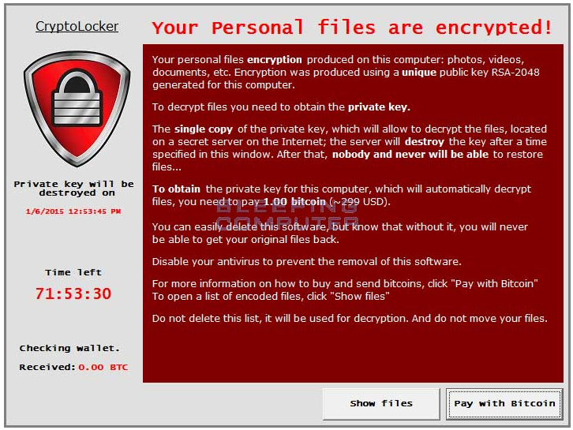

Slide 41
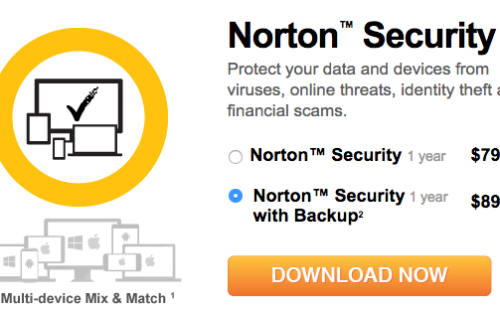

What to Do for Partial Protection

Slide 42
What to Do
Never click on unknown e-mail attachment
Never download application from uncertified source
Never accept offers from unverified senders
Always back up your systems
Optional:
Switch to G-mail for two factor authentication
Switch to Apple

Slide 43
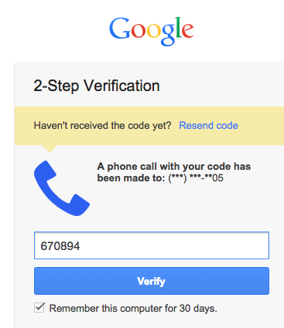
Gmail Two Factor Authentication

Slide 44
Advice
INTERNET is vulnerable
You may be “hacked”
Self-protection: set up backup computer
Security services available

